Slide 1
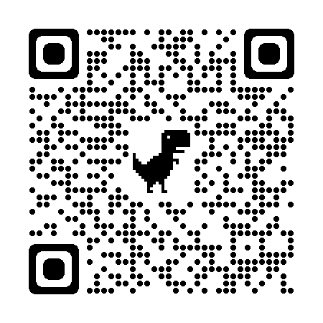
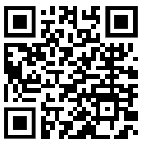
Seniors: Class of 2024
ALL seniors MUST pay dues.
Option 1: Basic Package Cost: $60 Includes:
Graduation costs – diploma cover, tickets, programs.
Senior Picnic (end of May)
Deadline May 1
Option 2: Advanced Package Cost: $110 :
Everything from Option 1
Yearbook at a discounted price: ($50)
Deadline: October 31, 2023
Separate activities (NOT INCLUDED with dues) and subject to change
Food truck lunch (October)
Main Event (February)
Waffle House breakfast (March)
T-shirt / hoodie
GoFan: 2024 Senior Dues
Sign up for REMIND to receive information about dues and events

